Slide 1
Responsibility Charting
Campus Training
June 2019

Slide 2
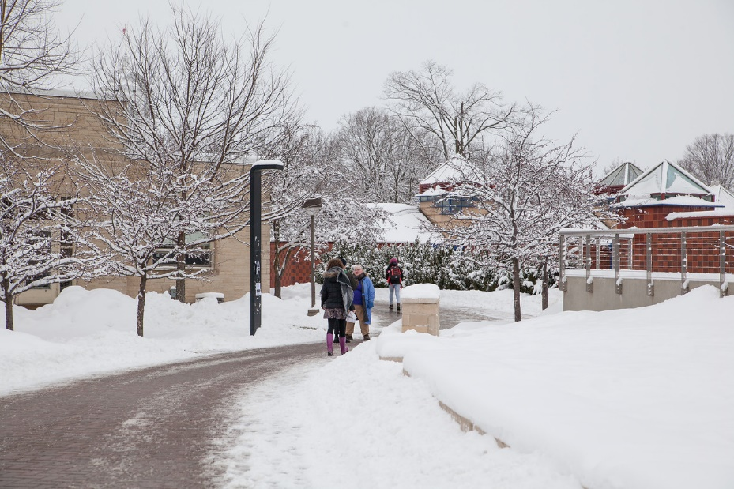
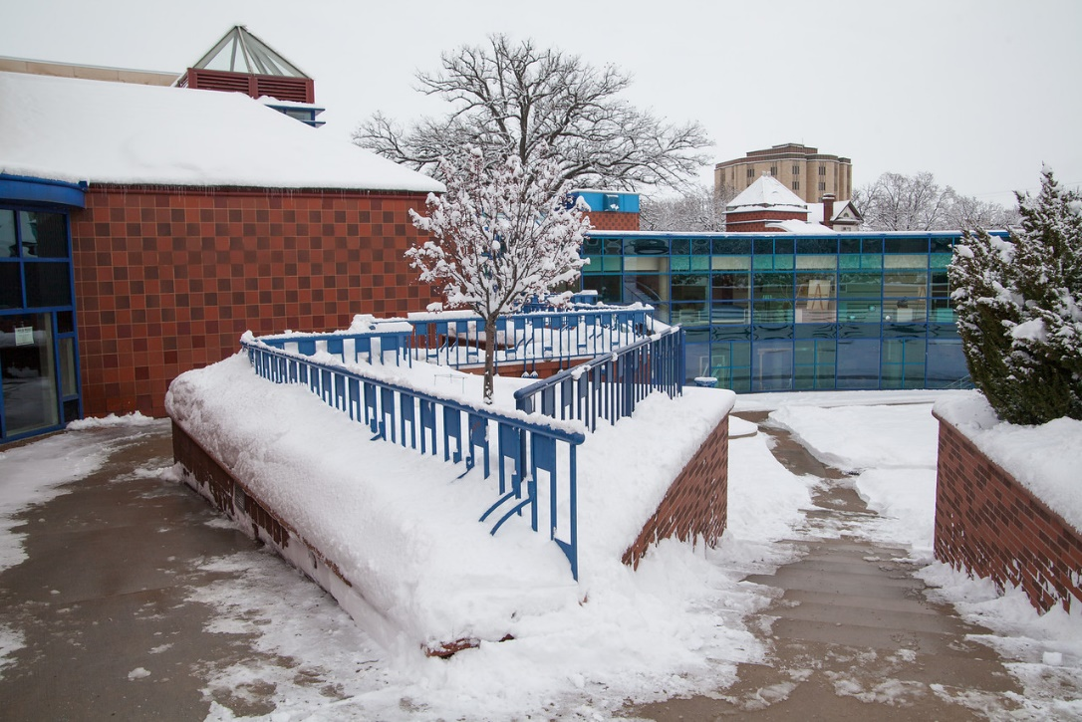
Who makes decision to close campus when severe weather hits?
Notes:
Even though its 80 degrees and sunny outside, let me take you back to those bitter cold days of winter. Do you remember going to bed, knowing a winter storm was brewing, and wondering if school/work would be cancelled tomorrow? Or waking up early and finding a new ‘world of white’ and wondering if the office was going to be closed? It’s a big decision for any university to make, and one that Lawrence University has to be prepared for multiple times per year.

Slide 3
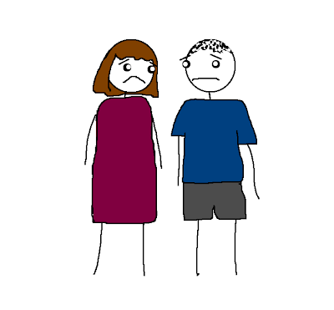
Consequences can be high
Safety of students, faculty and staff | Inconvenience for parents who need childcare when schools are cancelled | Worried parents
Notes:
The decision about whether or not to close campus has big consequences for students, staff and their families.
Students, faculty and staff need to feel safe walking and driving around campus. Just this past winter, a student at the University of Washington slipped on the ice and had a fatal fall.
Parents who work at Lawrence need to arrange for child care if schools are closed, but Lawrence is not. Having has much lead time as possible, either the night before, or early in the morning is important.
And finally, far-flung parents of students on campus are often also keeping tabs on the weather here in Appleton and need to be reassured that the university is considering safety of students when a storm is approaching.

Slide 4
While seemingly a simple decision, it used to be unclear at Lawrence
Who ultimately approves?
Who tracks the weather?
Who makes the reco.?
Who needs to be con-sulted?
Who needs to be in-formed?
Notes:
Last fall, the first few signs of bad winter weather brought to light the lack of clear decision making we had around this important issue. It wasn’t always clear about the roles the president, the provost, the VP student life and the facilities team played in making the decision to close campus or delay opening:
Who’s role was it to be tracking the weather?
Who’s role was it to be checking with other local organizations?
Once all the details were pulled together, who developed the final recommendation to close or not close campus? Did anyone in particular need to be consulted?
Who was the ultimate decision maker? Who had final approval?
And was there anyone who had to be informed before students, faculty and staff?

Slide 5
Lawrence University’s history with Responsibility Charting
Fall 2018 | President Burstein invited Jim Krantz, a former colleague at Columbia University, to campus to help the cabinet with decision making.
Dec. 2018 | Brokaw Central and CLC were trained in 2-day workshop
Winter-Spring 2019 | Brokaw Central, CLC, Admissions, and Cabinet begin implementing
Notes:
Fortunately, the confusion around this decision coincided with the decision to implement a new tool called “Responsibility Charting”.
“Responsibility Charting” was brought to Lawrence University by President Burstein through a former colleague at Columbia University, Jim Krantz. Mr. Krantz is the founder of WorkLab, a consultancy around Organization and Applied Research. He is an expert in the area of decision making and came to campus in the fall of 2018 to teach a two day seminar on decision making through Responsibility Charting.
While Brokaw Central and the Center for Career, Life, and Community Engagement (CLC) were formally trained during this session, several other departments have begun using this valuable new tool, including Admissions, Athletics and the cabinet.
Let’s take a deeper dive into what Responsibility Charting means….

Slide 6
What is Responsibility Charting?
A tool for improved decision making
Defines who needs to be involved and at what level, for a specific decision or project
Who is
Responsible?
Who is Accountable?
Who is Consulted?
Who is Informed?
Notes:
As organizations become more complex and fluid, traditional organization charts are often unable to describe how people actually need to work together — they do not capture the nuances and particularities that accompany specific issues.
Responsibility Charting addresses the question of who needs to be involved – and at what level – for specific decisions or projects.

Slide 7
There are many benefits of Responsibility Charting
Shared language
Flexibility – small groups or large departments, formal or informal
Clarifies roles and responsibilities
Improves accountability and encourages delegation
“We accomplished something that normally we would drag our feet on”
Ryan Gebler, Director of Financial Aid
Notes:
Responsibility Charting is a tool for improving decision-making and also:
Provides a shared, effective language about authority and responsibility
Is very flexible in its use – working with small groups or large departments, on small, or big and complex decisions
It clarifies roles amongst individuals, units, departments, or divisions, and
It improves accountability and sharpens patterns of delegation
As Ryan Gebler, Director of Financial Aid noted “Responsibility Charting helped us accomplish something that normally we would drag our feet on”

Slide 8
What goes into making a decision?
Initiating decision-making process
Developing recommendation
Signing off on a recommendation or alternative
Implementing the decision
Notes:
Before we get into the nuts and bolts of Responsibility Charting, its important to understand 1. the key steps in making a decision; and 2. the key roles involved in decision making.
Generally, there are 4 key steps in making a decision
You need someone to get the process started - someone who identifies the need for a decision and initiates the process
Second, you need to identify the person that will develop the recommendation. This person will identify the options, solicit input on those options, and provide a final recommended course of action
Third, someone needs to be the ultimate approver of that recommendation. Someone who has accountability for final ‘go’ or ‘no go’
And fourth, you implement the decision
Responsibility Charting focused on helping clarify the roles of various people in this process

Slide 9
What are the key components of decision-making?
Decisions
Whether or not to close campus
People or “Actors”
Facilities Management, President, Provost,etc.
Types of participation
Tracking weather, making decision, informing campus, etc.
Notes:
Said another way….There are three components of decision –making
The decision to be made (ex. Whether or not to close campus)
People or Actors (ex. Who’s involved in making the decision – Facilities Management, President, Provost, etc.)
Types of participation (Who tracks the weather, who has to be consulted, who is final decision maker, etc.)

Slide 10
Types of Participation in Decisions
Approve —signs off or vetoes a decision or selects from options developed by the R role.
A
Responsible —takes initiative, develops alternatives, analyzes the situation, involves necessary people, makes initial recommendation
R
C
Consulted — has right to offer input before decision is made. No veto power. Others may be consulted, those with “C” must be.
I
Informed — must be notified after decision is made, but before it’s announced; needs to know outcome but not be involved in making decision.
Notes:
So let’s look at the Types of Participation in Decisions in more detail:
The Approver signs off or vetoes a decision; or selects from options developed by the “R” role. They are the ultimate decision maker.
The person Responsible does the bulk of the work to develop the recommendation – they get the process started, analyze the situation, develop alternatives, get input from key people, and make the initial recommendation to the Approver
Those who are Consulted are people who have subject matter expertise or a critical point of view. They have a right to offer input before the decision is made; and it is incumbent on the person Responsible for the decision to consult them during the process. While others may be consulted, those with a “C” must be consulted.
Finally, some people must be Informed after the decision is made, but before its announced. They need to know the outcome, but are not involved in the decision making.

Slide 11
Let’s return to our campus weather closure decision
A
Approve — President Burstein
R
Responsible — VP Finance & Administration, Provost
C
Consulted — VP for Student Life, Director of Campus Safety, Director of Facilities
I
Informed — Crisis Management Team, Cabinet, Bon Appetit
Notes:
Returning to our campus weather closure decision, the cabinet worked through this decision utilizing Responsibility Charting and came up with the following RACI chart to clarify roles and responsibilities for this important decision:
The VP Finance & Administration, Chris Lee, and the Provost, Katie Kodat, have a shared responsibility for making the recommendation.
They need to consult with the VP for Student Life, Chris Card, the Director of Campus Safety and Director of Facilities, before a final recommendation is taken to President Burstein who is the ultimate approver of any decision to close campus.
Once the decision is made, the Crisis Management Team, the full cabinet, and Bon Appetit must be informed before being announced to campus.

Slide 12
Opportunities for Responsibility Charting
Big or small day-to-day decisions
Organization design
Initiative planning/ execution
Onboarding/ training
Group problem-solving
Analyze content of jobs
Notes:
We’ve shown you one example of how Responsibility Charting was used here at Lawrence. There are many other uses beyond day-to-day decisions including:
Organization design – helping with clarifying roles in decision making across an organization
Initiative Planning – breaking down a big initiative into smaller action items and clarifying roles
Onboarding/training – helping explain an employee’s role on a team
Problem solving – as in the case of financial aid, using it to figure out problems in making decisions or taking action
Analyze content of jobs – helping value a job by the role it plays in decision making

Slide 13
Tips from the pros….
Drive it from the top
Make sure everyone on team is trained
Have the discussion upfront
Be clear on what the decision is (often there is misunderstanding)
Look for too many “R’s” and “A’s” with one person
Where you are unclear or disagree on who has the “A”, get input from next level up
Notes:
To end, we’d like to share the learning and tips from Lawrentians that have already used Responsibility Charting
Its important to drive it from the top. If you don’t have your supervisor’s endorsement for the tool, it will be difficult to move ahead with execution.
Make sure everyone on the team is trained – this is critical to ensure you all understand the language of Responsibility Charting
Have the discussion upfront – its much easier (and more efficient) to start off with a discussion around roles and responsibilities before you begin a decision making process versus after you are down in the weeds!
Be clear on what the decision is – make sure everyone in the group is clear about the decision to be made. Often time, you will find different points of view and it is important to clear that up before you begin the process
Look for too many “R’s” and “A’s” – if you are working through charting for multiple decisions within a team and it seems like one person has all the “R’s or all the “A”s, explore if you can delegate the work more efficiently to spread out the work and the decision making.
Finally, if you are unclear or there is disagreement within the team on who has the “A”, seek your supervisor’s input for clarity.
Also remember that Human Resources is here to assist you on the way as you being your journey of Responsibility Charting. Thank you and I can now open it up for any questions.

Slide 14
Appendix

Slide 15
Appendix A Other Uses for Responsibility Charting

Slide 16
Unclear decision-making creates conflict, confusion, inactivity
You See Your Role As | Others See It As | Interpretation & Consequences
A | R | You are waiting to make final decision while expecting others to develop alternatives; others expect you to take the lead.
R | A | You want role of developing alternatives; they see your role as final "sign off." You are not involved as early as you desire.
C | I | You want to give input to the decision; others think you only need to be informed afterward.
I | C | You want to know the outcome but do not want to be involved; others will draw on your time, expecting input.
Notes:
And sometimes mistrust
Potential lack of action, with you blaming others for not delivering when they are looking to you.
I. Delays result when others wait for your response.

Slide 17
Another use is to analyze roles across decisions
For Individuals | Possible Consequences
Many R’s | Plays initiating role for too many decisions. Can person stay on top of so much?
No R’s or A’s | Possibly a weak role that could be enlarged or eliminated.
Many C’s | Key resource for information. Are demands excessive? Is more active role desirable?
Many A’s | Person has major role. Is authority too centralized? Could some be delegated?
Low Consensus | Confusion about a person’s role. Clarification is needed.
Compared to Person’s Style | Does pattern fit style of actor (i.e., either too little or too much involvement)?

Slide 18
Analyzing how particular decisions are made
Responses | Possible Consequences
No R’s | Job may not get done; everyone is waiting to approve, be consulted, or informed. No one sees own role as taking initiative.
Multiple R’s | Is it clear which "R" has lead role to ensure action on decision? Conflict, inaction
Multiple A’s | Diminished accountability. Blame shifting. Initiatives can languish – “bureaucratic inertia”.
Multiple C’s | Do so many need to be involved? Delays in decision making and added communication vs benefits of more input?

Slide 19
Appendix B Examples of Responsibility Charting at Lawrence University

Slide 20
Local scholarship for new student
Teams: Admissions and Financial Aid
Situation: Team felt like they were dropping ball on making decision; no one knew who ‘owned’ the decision
Accountable | Beth Petrie ( Director of Admissions)
Responsible | Gaelyn Rose (Assoc. Dir. of Admissions)
Consulted | Ryan Gebler (Dir. Fin. Aid & Enrollment Planning)
Informed | Local school counselors

Slide 21
Life after Lawrence Alumni Engagement Initiative
Teams: CLC and ACE
Situation: New project with multiple stake-holders. They wanted to ensure roles were clear from the beginning
Accountable | Dean of CLC and Associate Vice President of ACE
Responsible | Assistant Director of CLC, Alumni & Employer Relations
Consulted | Executive Director of ACE, LUAA Board, Faculty; CLC/Student Life staff; coaches; students, VP Student Life
Informed | LU President, Provost, VP Alumni & Development, Faculty, CLC/Student Life staff; coaches; ACE; Development; students

Slide 22
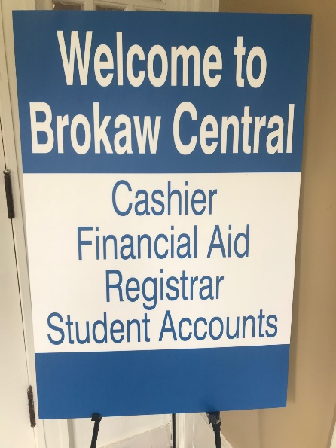
Naming Brokaw Central
Teams: Registrar, Financial Aid, Student Accounts
Situation: Unclear who owned decision on new name for renovated space in Brokaw Hall. Leadership spanned three departments
Accountable | President, VP Admissions & Financial Aid, Provost, VP Finance
Responsible | Registrar
Consulted | Brokaw Central Team
Informed | Brokaw Central Team
Notes:
“we had been sitting on it for months and months.”

Slide 23
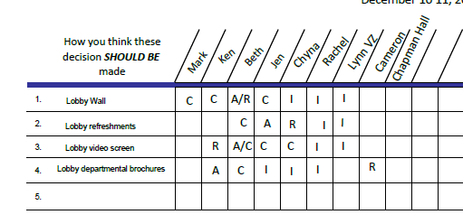
Admissions Lobby
Teams: Admissions
Situation: Clarify decision making for lobby elements

